Slide 1
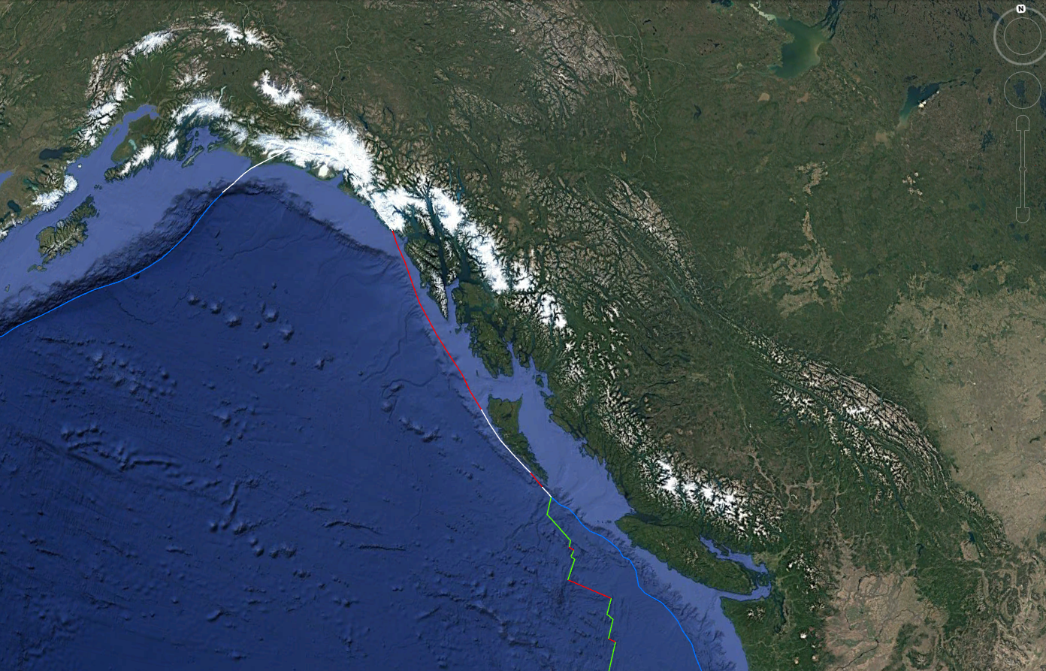
Coastal British Columbia
Earthquakes
Ashley Tegart, MSc candidate
Fall 2024

Slide 2
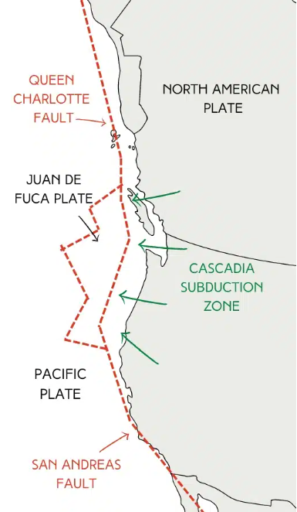
BC Costal Earthquakes
Ring of Fire
Subduction zones
Zones & Plates
St. Elias Region and SW Yukon Territory – Pacific plate
Queen Charlotte Fault
Cascadian Subduction Zone – Juan de Fuca plate
Measurements
Magnitude, intensity, and depth
Concerns
Earthquake & tsunami zone preparedness
Seasons of increased activity?
Total Prepare: Emergency Preparedness Solutions – Earthquakes in Canada

Slide 3
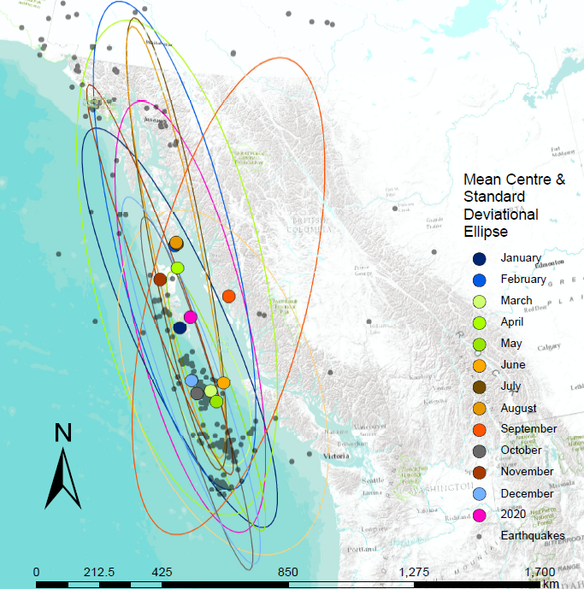
Current Research and Literature
3+ Magnitude Earthquake Distribution
British Columbia, 2020
“The current dehydration of these fracture zones [from the hydrated mantle in subduction zones] coincides with the current locations of the highest rates of earthquakes”
Variable water input controls evolution of the Lesser Antilles volcanic arc
Cooper, G., et al. (2020) in Nature
Summary of BC EQs (2020, 3+)
Month | Frequency | Distribution
January | high | mod
February | mod | low
April | low | high
June | low | high
July | high | low
August | high | low
KPU GEOG 4380 GIScience Lab, (Tegart, 2021)

Slide 4
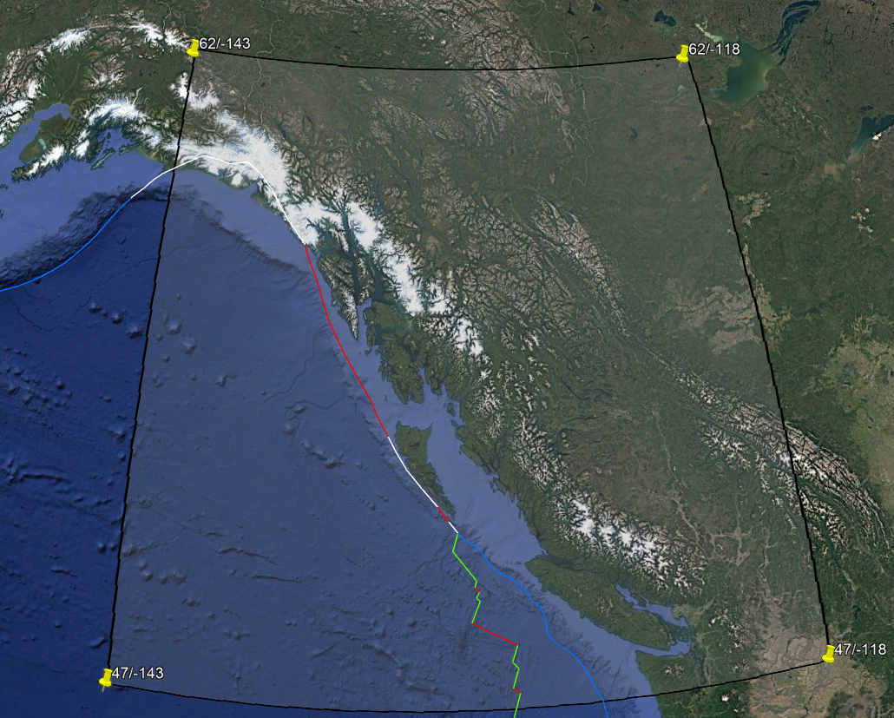
Earthquake Data Summary
 | Mean | Range
Magnitude | 3.4 | *lowest max
 | min: 3.3 (Jun)/3.4 (Aug) | min: 5.3* (Feb/Aug)
 | max: 3.5 (Dec) | max: 6.5 (Apr/Oct)
Depth (km) | 9.60
 | min: 7.76 (Aug) | min: 0 (all)
 | max: 10.37 (Dec) | max: 67.23 (Nov)
Frequency | 38.82
 | min: 21.8 (Aug) | min: 2 (Jun)
 | max: 46.8 (Dec) | max: 160 (Dec)
Distribution | high (Northward, Jul/Aug)
 | low (Dec)
Summary of BC EQs (2020, 3+)
Natural Resources of Canada Earthquake Database
Years: 2013-01-01 00:00:00 to 2023-12-31 23:59:59 (UTC)
Region: Latitude: (min) 47; (max) 62 Longitude: (min) -143; (max) -118
Magnitude: 3 to 10
Depth: 0 to 100km
Notes:
Magnitude:
Average: min = Mar, Jun, Aug, Sept 3.33 to 3.38 / max = Dec 3.5
(overall max = 6.5 Apr/Oct)
Depth/km Average: min = May-Aug 7.65 to 9.38 (Aug lowest) / max = Sep-Apr (Dec highest)
(overall min = August / Overall max = Nov)
Frequency
Average (comparing month-month): min = Jun (22.4) and Aug (21.8) / max = Jan (43.2) and Dec (46.8)
Average (comparing years): min = Aug 262/ overall max = Dec 562

Slide 5
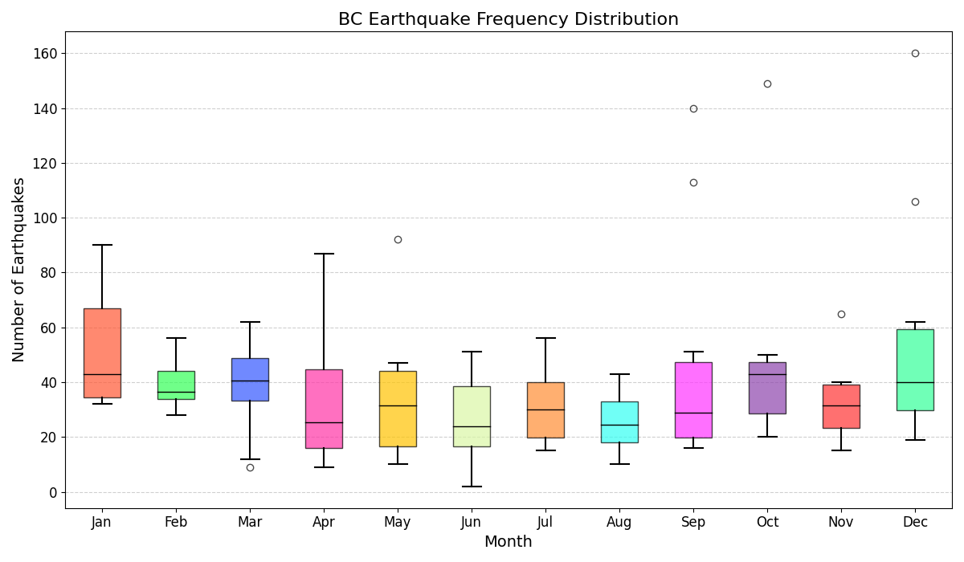
Earthquake Frequency
Peak
January + December
~21.2%
Downward Trend
June to August
~18.1%
Consistently inconsistent
Frequency of Earthquakes in
Coastal British Columbia (2014-2023),
Tegart, Ashley (2024).
Consistent low frequency
Notes:
WHISKERS – highest and lowest counts (symmetric whiskers show a more normal distribution = AUGUST) ORANGE LINE – Median counts (Jan, March, Dec = higher activity?)
BOX – 50% (greater variability = Jan, September / least variability = Aug)
OUTLIERS – Sep, Oct, Dec

Slide 6
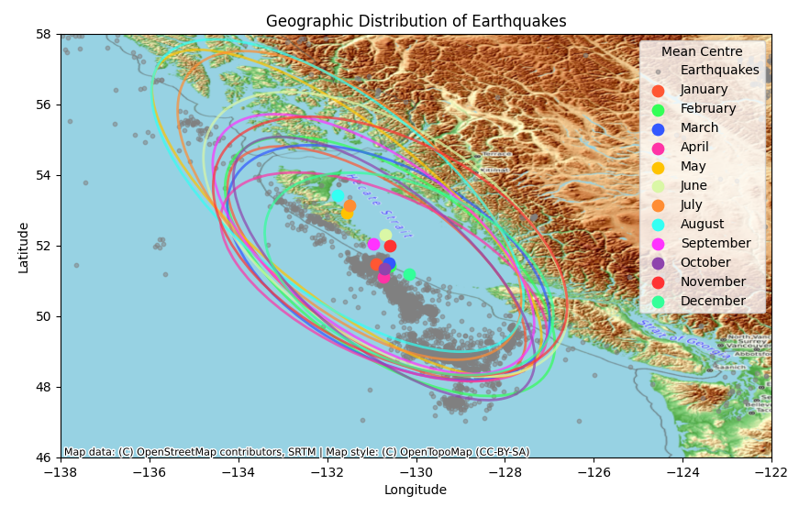
Geographic Distribution, 2014-2023
Concentration
Queen Charlotte Fault
(h) Extend NW May-Aug
(w) Extend
November
Geographic Distribution of Coastal
British Columbia Earthquakes (2014-2023),
Tegart, Ashley (2024).
Notes:
Total
4657
Region
Axe point NWT, Spokane, Coastal Pacific, SE Alaska

Slide 7
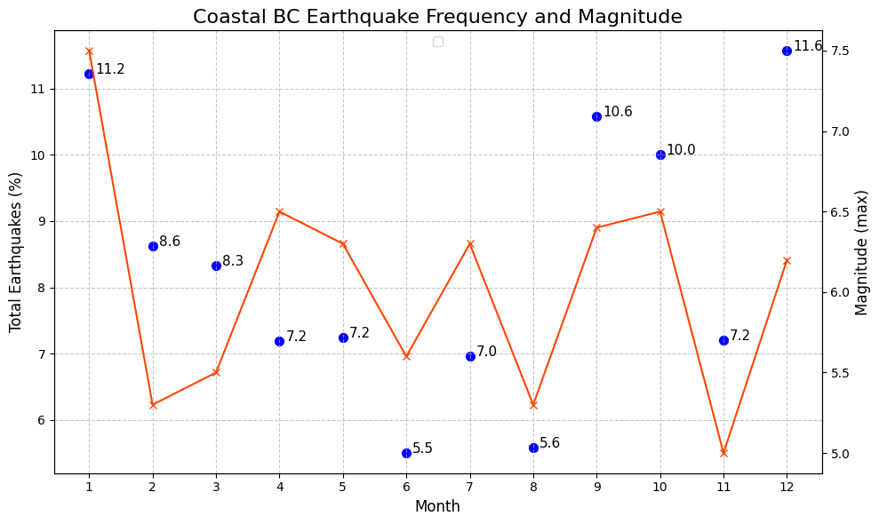
Influenced by Temperature…?
ERA5 Daily Aggregates
Climate Reanalysis
mean 2m surface temperature
2018 Avg count (449/465.8)
Avg mean Mag (3.5/3.4)
Max Mag (6.5)
Avg mean depth (9.92/9.55)
2nd lowest depth (39.32)
Peak 2M_ST
August
2014- 2023 Coastal British Columbia
Earthquake Frequency & Magnitude, Tegart, Ashley (2024).

Slide 8
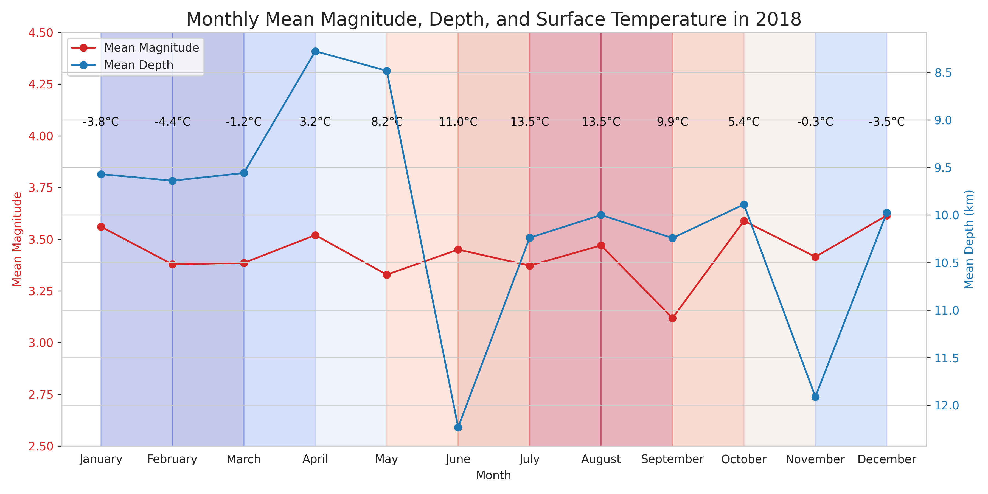
2018 Sample Aggregate
2018 Coastal British Columbia
Earthquake variables comparison, Tegart, Ashley (2024).

Slide 9
Resources
Colab (Julyter) notebook: link
username: ashley.d.tegart
notebook: EQ_Data_2014_2023.ipynb
Preliminary Research:
- Brogan, Caroline (June 30, 2020). Study reveals how water in deep Earth triggers earthquakes and volcanic activity, Imperial College London, [summary of Cooper et al.’s article]. Retrieved link
- Cooper, G.F., Macpherson, C.G., Blundy, J.D. et al. Variable water input controls evolution of the Lesser Antilles volcanic arc. Nature 582, 525–529 (2020). Retrieved
https://doi.org/10.1038/s41586-020-2407-5
BC EQ Data
Obtained from Natural Resources of Canada Earthquake Database

